Slide 1
Artificial Neural Network

Slide 2
Contents
Introduction
Biological Neuron
Perceptron
ANN Architecture
Single Layer ANN
Multi Layer ANN
Types of Artificial Neural Network

Slide 3
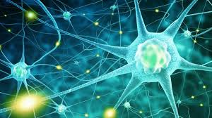
Introduction
The term "Artificial Neural Network" is derived from Biological neural networks that develop the structure of a human brain.
Human brain that has neurons interconnected to one another, artificial neural networks also have neurons that are interconnected to one another in various layers of the networks. These neurons are known as nodes.
The main objective is to develop a system to perform various computational tasks faster than the traditional systems.
These tasks include classification, approximation, optimization, data clustering and pattern recognition.

Slide 4
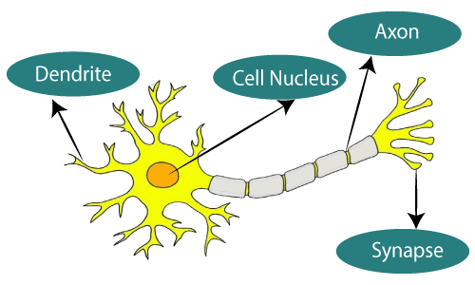
Biological Neuron
Dendrites − They are tree-like branches, responsible for receiving the information from other neurons it is connected to.
Cell nucleus- It is the cell body of the neuron and is responsible for processing of information.
Axon − It is just like a cable through which neurons send the information.
Synapses − It is the connection between the axon and other neuron dendrites.

Slide 5
Biological vs Artificial Neural Network
Biological Neural Network | Artificial Neural Network
Dendrites | Inputs
Cell nucleus | Nodes
Synapse | Weights
Axon | Output

Slide 6
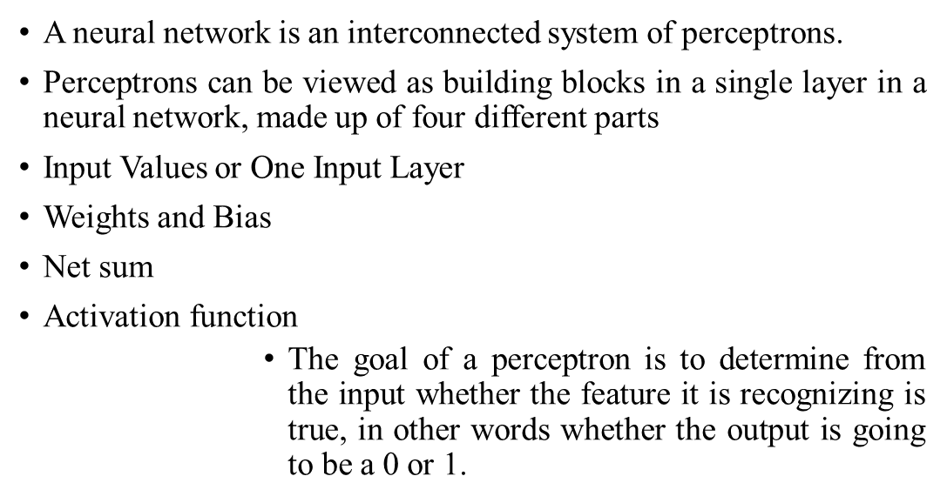
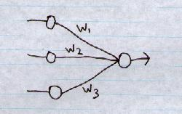
Perceptron

Slide 7
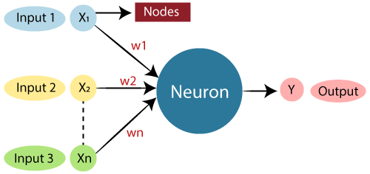

Single Layer ANN

Slide 8
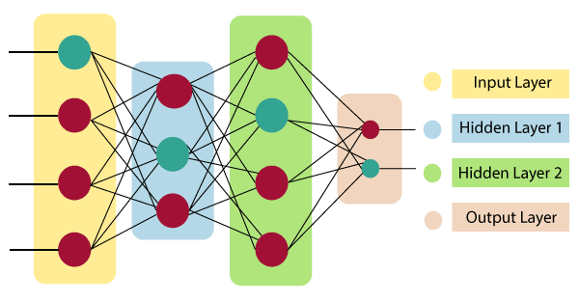
Multi Layer ANN
Input Layer:
As the name suggests, it accepts inputs in several different formats provided by the programmer.
Hidden Layer:
The hidden layer presents in-between input and output layers. It performs all the calculations to find hidden features and patterns.
Output Layer:
The input goes through a series of transformations using the hidden layer, which finally results in output that is conveyed using this layer.

Slide 9
Types of Artificial Neural Network
There are various types of Artificial Neural Networks (ANN) depending upon the human brain neuron and network functions.
Feed-Forward ANN:
A feed-forward network is a basic neural network comprising of an input layer, an output layer.
Through assessment of its output by reviewing its input, the intensity of the network can be noticed based on group behavior of the associated neurons, and the output is decided.

Slide 10
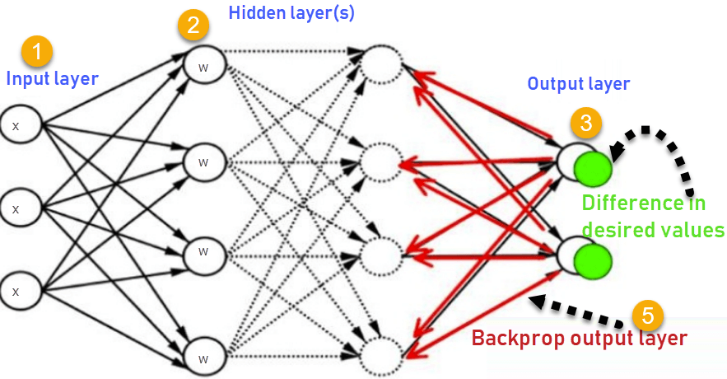
Cont…
In this type of ANN, the output returns into the network to accomplish the best-evolved results internally.
The feedback networks feed information back into itself and are well suited to solve optimization issues.
The Internal system error corrections utilize feedback ANNs

Slide 11
Thank
You

